Slide 1
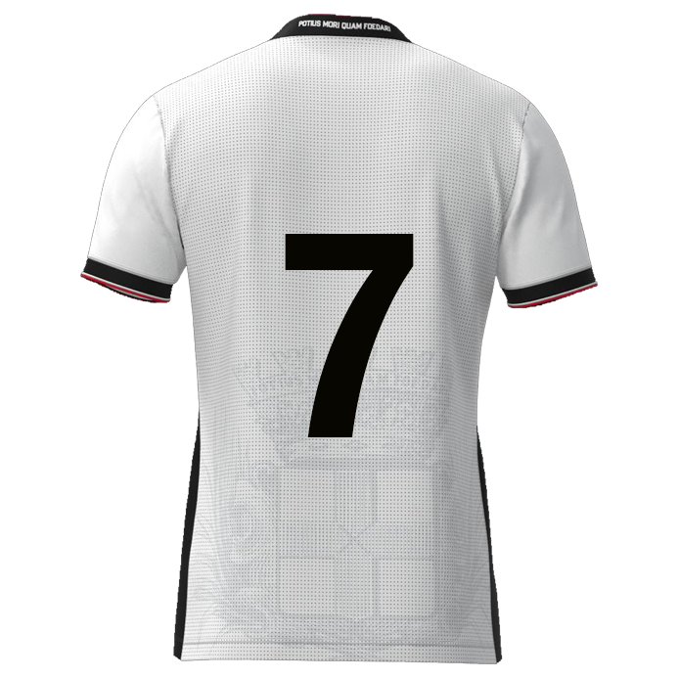
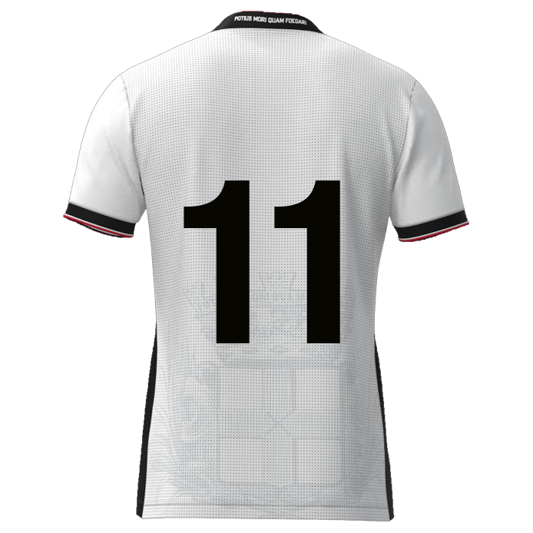

Slide 2

Browse
Foto
DATE: DD-MM-JJJJ
Player name
DD/MM/YYYY: Game / Training
DD/MM/YYYY: Game / Training
DD/MM/YYYY: Game / Training
DD/MM/YYYY: Game / Training
DD/MM/YYYY: Game / Training
DD/MM/YYYY: Game / Training
DD/MM/YYYY: Game / Training
Dribbling past opponent
xx
xx%
Deep runs
Composure
Speed
Agility
Bravery
Flair
xxxx
Fast winger nr. 07 & 11
9
11
7
xxxx
8
10
6
xxxx
xx
xx
xx
xx
5
2
4
3
xxxx
1
xxxx

Slide 3
FW#7/#11 | Rating | Vermenigvuldigingsfactor | Resultaat
Dribbling past opponent | 0 | 1,1 | 0
DieptDeep runse loopacties | 0 | 1,1 | 0
Composure | 0 | 1 | 0
Speed | 0 | 1,1 | 0
Agility | 0 | 1,1 | 0
Bravery | 0 | 1,1 | 0
Flair | 0 | 1 | 0
 |  | Gemiddelde rating | 0,00

Slide 4
Fast winger #07 #11
9
11
7
Dribbling past opponent
Speed
Bravery
10
8
Deep runs
Agility
6
5
2
4
3
Composure
Flair
1

Slide 5
Dribbling past opponent
Deep runs
Composure
Shooting from distance
“Dribble resulting a duel, after which player remains in possession, resulting in >5m forwards displacement”
“Forward runs starting from a deeper position on the field, usually from midfield or defense, moving into attacking areas”
“Calm and controlled under
pressure, to make good decisions
and execute skills accurately”
“Shot from open play from
outside the score box”
Tricks
Power or speed
Inside - outside
Timing
Combination play
Frequency?
End result
?
Timing
Direction
Speed level
Recognition
Starting position
Sacrifice run
Frequency?
End result
?
Danger zones
Overview
(Body)position
Goal oriented
Goal attempts
Between the posts
End result
?
Type of shot
Short or deep angle
Power
Preparation
Frequency
End result
?
Speed
Agility
Bravery
Flair
“Quickly change direction, accelerate, and control body movement while maintaining balance”
“The willingness to face physical challenges, difficult situations, or potential contact without fear”
“Ability and confidence to perform creative, skillful, and often unexpected actions with the ball”
“Top speed and acceleration capabilities”
Top speed
Acceleration
Stride length
Big / small distance
First meters
End result
?
Reaction speed
Footwork
Balance
Center of gravity
Change of direction
Mobility
?
Initiative
Taking risks
Freedom
Surprising
Creativity
Confident after mistakes
?
Appearance
Confident
Present
In control
Excited
Boost at heat of the moment
?

Slide 6



